Slide 1


Slide 2
Team
Nachiappan Lakshmanan
Srinivasan Sundar
Ashwin Srinivasan
Madhu Madhavan
Chandan Yadav

Slide 3


Slide 4


Slide 5
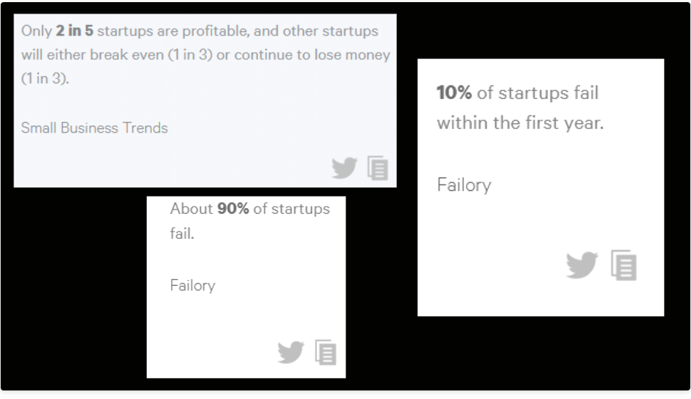

Slide 6


Slide 7


Slide 8


Slide 9
